Slide 1

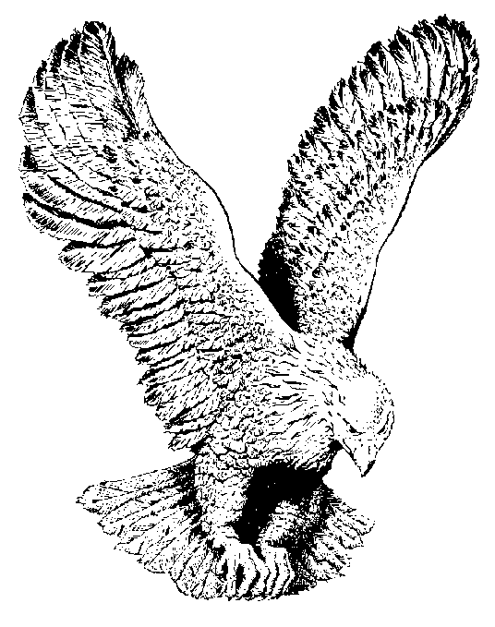
916 I OWE MY LIFE TO THE CRUCIFIED
Lord where would I be if you had not gone
up that lonely hill to dark Calvary
What is man that you came, leave your glory
above and suffered in deep agony,

Slide 2
CHORUS
I owe my whole life to the crucified one
Who gave His all for me
With all that's in me I will praise His holy name
Praise God for the crucified one.

Slide 3
He walked that lonely hill with me in mind,
I was wretched, naked and blind;
My Lord was so brave, holy one up there
Thank God for the crucified one.

